Slide 1
Reproductive Health Concepts
Manuja Perera
Department Of Public Health

Slide 2
Reproductive Health
A state of complete physical, mental and social well-being, and not merely the absence of reproductive disease or infirmity.
NOT about
Controlling population growth
Preventing maternal mortality
Preventing sexually transmitted infections (STIs)

Slide 3
Reproductive Health
Implies that people are able to have
a satisfying and safe sex life
the capability to reproduce
the freedom to decide
if,
when and
how often to do so.

Slide 4
Reproductive Health – ‘Freedom’
The right of men and women to be informed and to have access to
safe, effective, affordable and acceptable methods of family planning of their choice,
other methods of their choice for regulation of fertility which are not against the law,
appropriate health care services that will enable women to go safely through pregnancy and childbirth and provide couples with the best chance of having a healthy infant
Contraception
Safe Abortion
Safe Motherhood

Slide 5
Strategies
Enhance Reproductive Health
Promote Reproductive Rights

Slide 6
Women in reproductive age group
15 – 49 years
Adolescent
Child
Men

Slide 7
Reproductive health impact
Physical wellbeing
Mental wellbeing
Exploitation/ Abuse
Unwanted pregnancy
Social wellbeing
Diseases
Death
Relationships
Reproduction

Slide 8
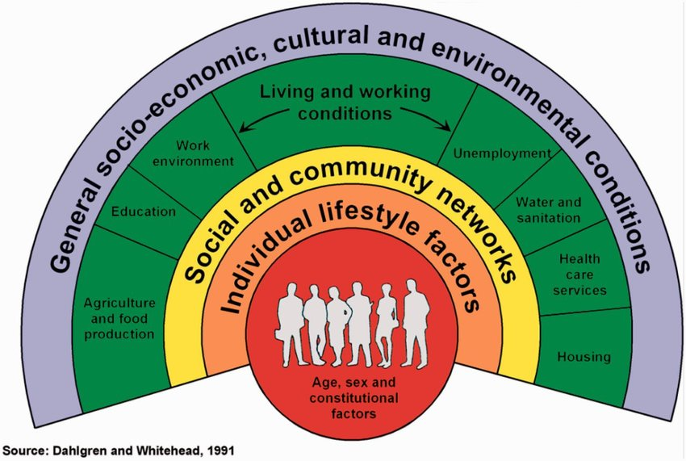
reproductive health Determinants

Slide 9
Actions to Promote Reproductive health
Offer men & women services to achieve optimal reproductive health
Contraception
Family planning

Slide 10
Questions?

